Slide 1
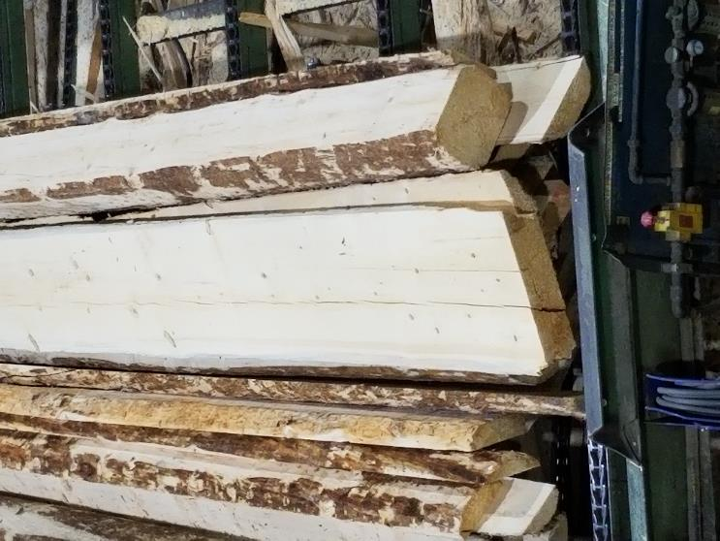
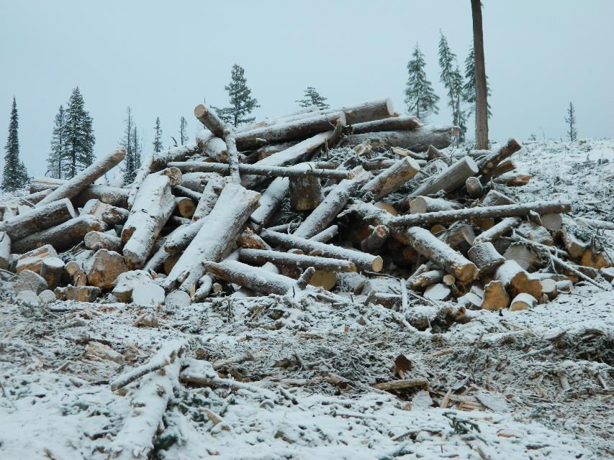
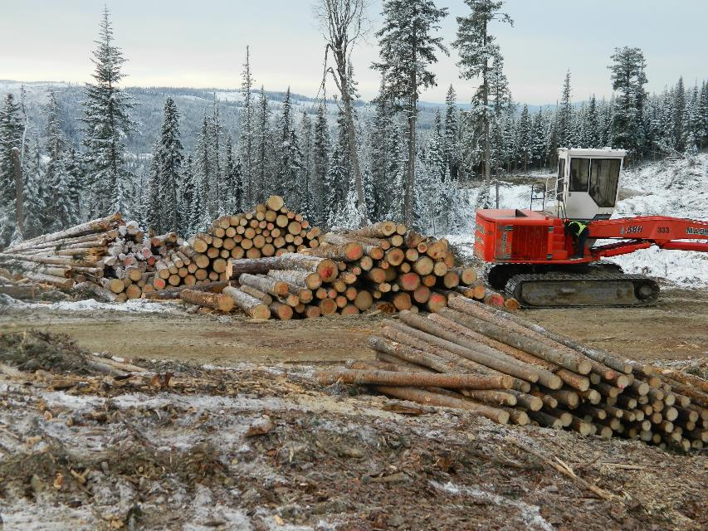
Comparison of Volume, Lumber and Value Yields when Processing Green vs. Grey Spruce Logs –
Stage (3+years past mortality) Spruce Beetle attacked Logs a case study
April 2020
David Belyea
Bruce Lehmann
Vladimir Strimbu
Peter Dyson
Copie et redistribution interdites. Copying and redistribution prohibited.

Slide 2
Study objectives
To Identify loss in value and recovery of grey stage 3⁺ years since death versus green spruce logs. Both at the logging operation and at the mill level.
Work with three mills and other collaborators to log and mill green and grey stage spruce logs from similar stands in the northern interior and measure the results.
Log and deliver similar size samples of logs (~500 m3) of both grey stage and green logs per mill study. Similar sample sizes to 3 Mountain Pine Beetle Studies ~13 years ago.
Logging operation study
  Determine age since death of the grey stage sample.
  Determine the grades of logs delivered in each sample sent to the three sawmills and chip plant.
  Determine the loss in fibre during the logging operation from breakage and rot.
Mill run study
  Measure lumber volume losses at the sawmill and planer mill ( 3 mill sites)
  Measure grade out-turns from the different mill runs
  Compare the value difference per cubic metre of grey stage logs versus green logs for a similar log profile.

Slide 3
Project Participants
Participant | Activity | Funding or In-kind
Canfor (Polar Division) and Dunkley (Hixon) | Log deliveries and Mill Runs | Member Fees and In-Kind
West Fraser | Mill Runs | Member Fees and In-Kind
Tolko and Sinclar Group | Project Support | Member Fees
British Columbia Ministry of Forests (FLNROD) | Support to FPInnovations for project planning, data collection, log scaling and summary report | Provincial contract(s) and In-Kind Scaling
College of New Caledonia | Age since death study on blocks logged | In-kind work funded by Natural Sciences and Engineering Research Council (NSERC)
Council of Forest Industries (COFI) and Canadian Mill Services Association (CMSA) | Planner Mill Runs data collection | In-Kind (Client membership from participating mills)
Total Project Cost |  | ~$250,000 + In Kind contributions
LEARN MORE

Slide 4
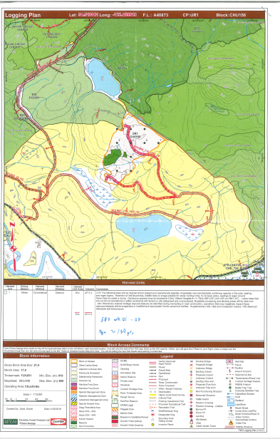
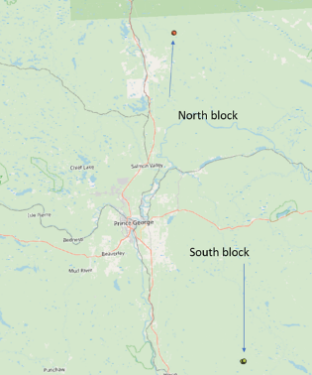
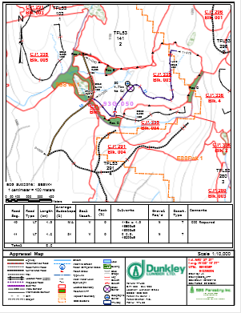
The beetle attacked site (North Block-Grey Stage Spruce- Canfor) was located approximately 80 km northeast of Prince George and the non beetle attacked site (South Block-Green Spruce - dunkley) was approximately 40 km south east of Hixon B.C. Table 2 shows the study sites, stand parameters and stem volume from the timber cruise.
Study Sites

Slide 5
Harvest Blocks Study Sites
Spruce portion of Stands
 | BGZ | Elevation (m) | Block Sw % By Volume | Average DBH(cm) | Average Height (m) | Gross Vol./stem (m³) | Net Vol./stem (m³) | Average Age (years)
Site 1: FJ3URI Block: Chu 156 Grey Stage Spruce | SBS WK1 | 1000 | 43% | 39.8 | 27.7 | 1.32 | 0.81 | 200 (1)
Site 2: 53/335 Block: 004 Green Spruce | SBS WK1 | 1150 | 61% | 46.9 | 29.4 | 1.77 | 1.55 | 212 (2)
LEARN MORE
From the College of New Caledonia Dendrochronology sample the average age of the dead spruce sample was 200 years old.
Cruise sample average age from green stand.

Slide 6
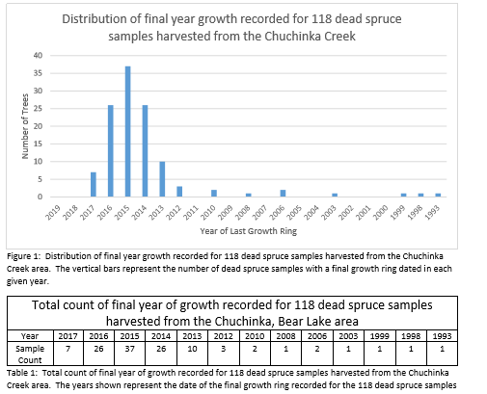

Last year of Growth
LEARN MORE

Slide 7
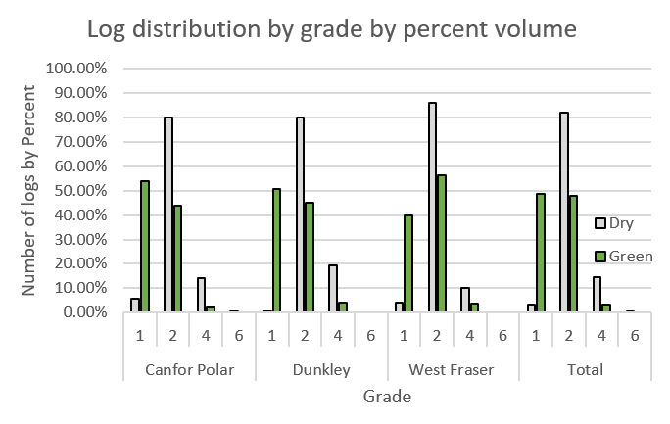
Summary of Sawlog Deliveries to the Three Mill sites
Avg. Log Vol./ m3 Delivered
Grey Stage Green
Canfor 0.423 0.474
Dunkley 0.453 0.393
West Fraser 0.475 0.395
Average 0.448 0.416
LEARN MORE

Slide 8
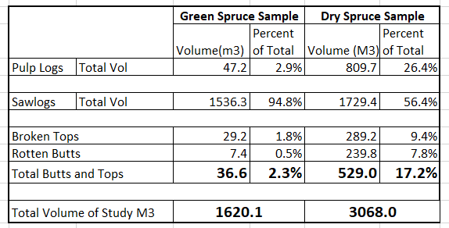
Summary
LEARN MORE

Slide 9
Summary Observations Bush Operation
Processor operators were challenged with determining whether or not a log was rotten (pulp log) or sound (saw Log), especially if wood was white and punky.
Larger dead spruce produced a significant amount of butt logs that became pulp.
Significant volume was lost from both long butting and broken tops on larger stems which were broken off at the stump – approximately 17% volume loss.
Pure live green spruce stands produce very low volumes of pulp logs – approximately 3%.
LEARN MORE

Slide 10
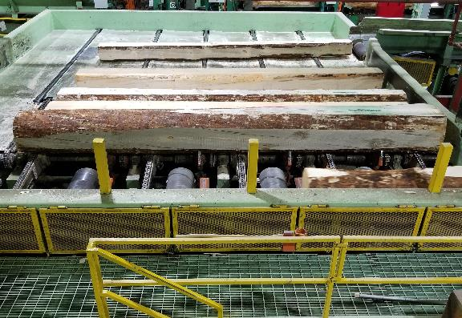
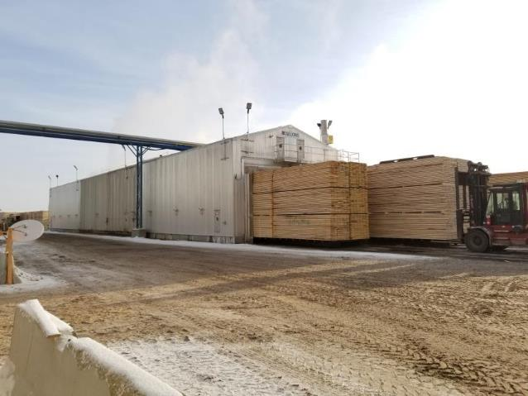
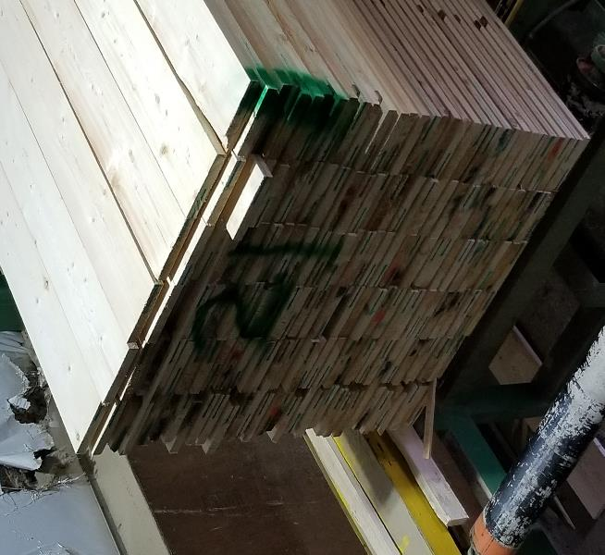
Effects of Spruce Beetle Attack on Lumber
Report on Sawmill Tests
Bruce Lehmann David Belyea
May 8, 2020

Slide 11
Purpose and Scope
Purpose:
  Determine the change in lumber recovery and value caused by the attack of spruce bark beetle.
Method:
  Sawmill tests of samples of green and dry (dead, attacked), spruce
  Measure the log volume in each sample
  Measure the volume of lumber produced in the sawmill
  Measure the volume and grade of lumber after drying and planing.

Slide 12
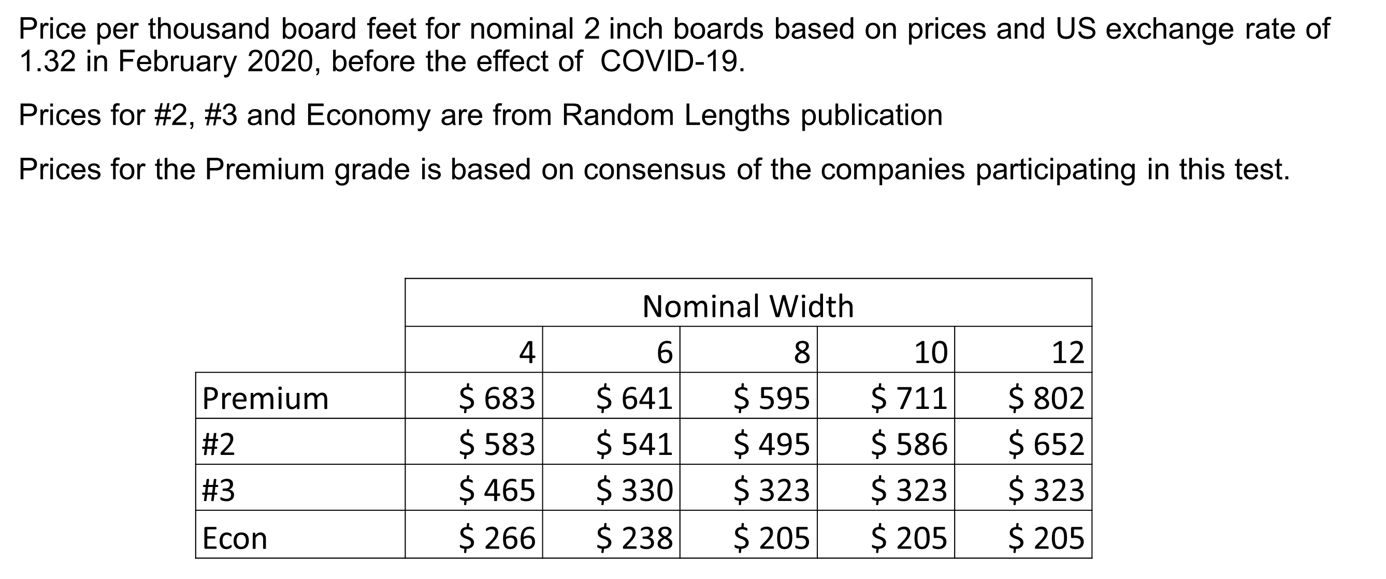
Lumber Price Table

Slide 13
Change in Lumber Recovered
Lumber is lost in the sawmill and planer operations due to breakage and other factors.
This table quantifies the extra losses for dry wood compared to green.
 |  | Average | Coef. Of Variation
Sawmill Volume Loss |  | 8.3% | 17.7%
Planer Volume Loss |  | 3.7% | 66.9%

Slide 14
Grade Loss: Percentage 2&Btr Grade
An simple indictor of the grade loss, is the change in the amount of #2 and Better grade that was produced.
 | Average | Coef. Of Variation
Green | 80.0% | 7.3%
Dry | 51.8% | 14.1%

Slide 15
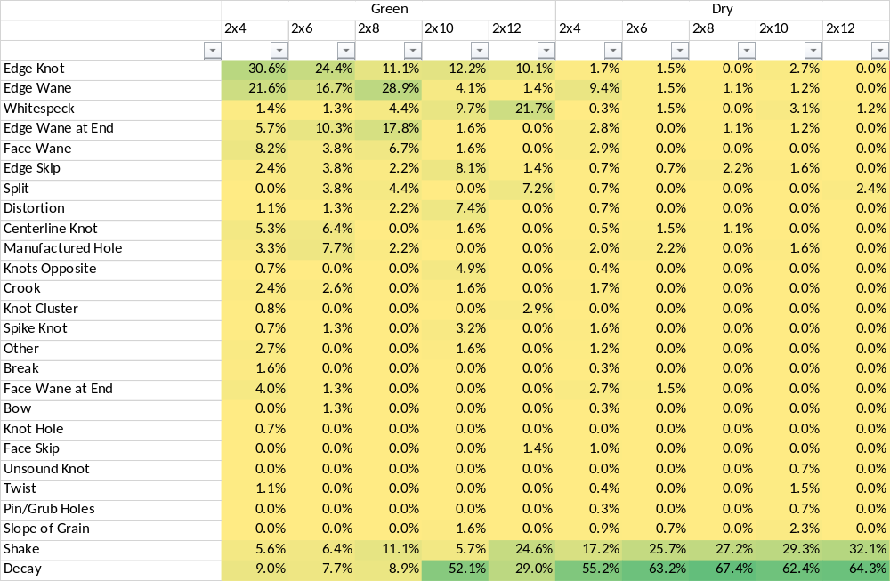
Reasons for Downgrade to #3
Percentage of times, averaged from the three mills, a specific defect caused the down-grade to #3 lumber
Note: some boards have two downgrade reasons, so columns do not sum to 100%
Green boards, other than 2x10’s mainly affected by natural or manufacturing
defects
Wide green boards affected mainly by decay and shake
All dry board sizes affected by decay and shake

Slide 16
Observations: Decay
Sapwood rot was seen on many logs. The rot was often so extensive that the debarker removed all of the sapwood down to the heartwood.
Unless decay has progressed to an advanced stage, it’s difficult to see in the sawmill, and by extension, in the bush.
The process of kiln drying and planing causes a color change that makes the stain or decay much more visible. The heat in the kiln probably oxidizes the decay and the planing removes the saw marks and tear-out that obscure the surface.
The color change is only an indicator of possible decay. If the wood is still sound, then the color change is a categorized as stain, which is not a grade reducing factor. If the wood is unsound, then it has progressed to rot/decay. In other words, there is a difference between diesel stain and diesel rot.
The data from the reasons why lumber was down-graded indicates that the wide boards, only possible from larger and older trees, have more decay.

Slide 17
Value Loss
Summary of how lumber value loss contributes to the loss in log value
 |  | Average | Coef. Of Variation
Average Lumber Value
Green | $/mbf | $ 498.82 | 2.5%
Dry | $/mbf | $ 367.06 | 8.0%
Value Loss | $/mbf | $ 131.76 | 24.9%
Log Value
Value Loss | $/m³ | $ 54.76 | 15.1%
Value Loss |  | 35.5% | 18.0%
Interpretation:
A dry spruce log is worth about $55/m³ less than a green log.

Slide 18
Mountain Pine Beetle Mill Test Results
For comparison, these are the results from the Mountain Pine Beetle sawmill recovery tests in 2007-2008
 |  | Average Diameter (inches) |  | Sizes produced | Change from Green to Dry
 |  | Green | Dry |  | Lumber Recovery | Lumber Value | Log Value
Mill 1 | Tolko - Quesnel | 7.51 | 7.31 | 2x4, 2x6, 2x8, 2x10 | -7.1% | -23.5% | -28.9%
Mill 2 | Canfor - Rustad | 7.44 | 7.18 | 2x4, 2x6, 2x8, 2x10 | -8.2% | -11.9% | -19.1%
Mill 3 | Weyerhaeuser - Princeton | 7.29 | 7.26 | 1x4, 2x4, 2x6 | -1.5% | -14.1% | -15.4%
 | Average |  |  |  | -5.6% | -16.5% | -21.1%

Slide 19
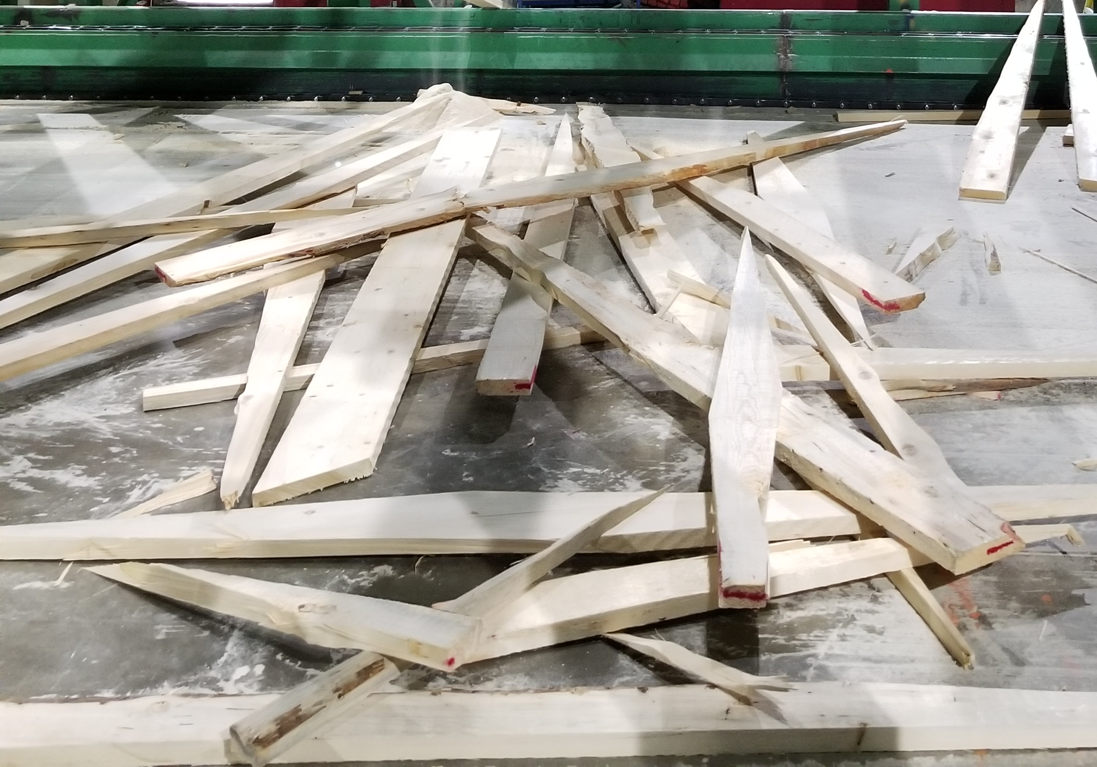
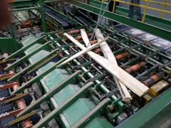
Other Losses and Observations
Mill production is slowed because of:
  broken boards crossing on lumber decks
  the need to edge more boards creates a bottleneck at the edger.
Logs, cants and lumber can break apart during processing and jam up in the equipment
More people are needed wherever boards need to be sorted due to board crossing and to remove broken boards.
Spiral checks in large dry logs are the source of most of the breakage. However, for this sample, the amount and severity of the checking was not apparent to the log scalers.
These logs were processed quite quickly after harvesting. Most logs sit in the sawmill log yard much longer and this appears to result in more decay.

Slide 20





GET IN TOUCH/COMMUNIQUEZ AVEC NOUS
Peter Dyson – peter.dyson@fpinnovations.ca
Vladimir Strimbu – vladimir.Strimbu@fpinnovations.ca
David Belyea – david.Belyea@fpinnovations.ca
Bruce Lehmann – bruce.Lehmann@fpinnovations.ca
fpinnovations.ca
blog.fpinnovations.ca

